Slide 1

CSE 4000 : Project/Thesis
AN ADAPTIVE BENGALI VOICE CONTROLLED SYSTEM FOR AUTONOMOUS VEHICLE NAVIGATION
Supervised By:
Dr. Mohammad Sheikh Sadi
Professor,
Department of Computer Science and Engineering,
Khulna University of Engineering & Technology
Presented By:
Naimur Rahman
Roll: 1907031
Department of Computer Science and Engineering,
Khulna University of Engineering & Technology

Slide 2
Overview
Introduction and Problem Statement
Literature Review
Objectives
Methodology
Results and Result Analysis
Real Time Testing
Progress
Limitations and Future Planning
Conclusion

Slide 3
Introduction
Bengali speech recognition systems remain underdeveloped.
Existing systems rely heavily on cloud-based APIs.
This research focuses on creating an offline, Bengali-specific voice control system.
Commands for vehicular movement are recognized in real-time.
Attempts to accurately predict the correct command even with moderately defective inputs.

Slide 4
Problem Statement
Lack of efficient, offline Bengali voice recognition systems.
Existing systems mostly focus on English or cloud-based APIs.
Bengali-specific solutions are hard to come by in low-computational devices.
Need for real-time performance and dependable accuracy.
Very low adaptability for defective commands.

Slide 5
Literature Review
No. | Paper | Language | Method | Accuracy
1 | Adrisya Sahayak: A Bangla Virtual Assistant for Visually Impaired [1] | Bengali | Google API | 94.07%
2 | A Digital Personal Assistant using Bangla Voice Command Recognition and Face Detection [2] | Bengali | Cross Correlation | 79.50%
3 | Bangla Short Speech Commands Recognition Using Convolutional Neural Networks [3] | Bengali | MFCC Features | 74.01%
4 | Bangla Voice Command Recognition in End-to-End System Using Topic Modeling Based Contextual Rescoring [4] | Bengali | Recurrent Neural Network | 74.20%
5 | Features of Speech Commands Recognition Using an Artificial Neural Network [5] | English | BiLSTM | 91.05%

Slide 6
Objectives
To develop an offline voice recognition system for Bengali vehicular commands.
To recognize several specific Bengali commands for movement.
To achieve dependable accuracy with a CNN-LSTM model.
To evaluate real-time system performance.
To use data augmentation for robust model generalization and defect adaption.

Slide 7
Methodology
Dataset
Very small dataset that is custom made.
Raw dataset is made for 5 different Bengali commands.
“Samne Jao” (Move Forward)
“Pichone Jao” (Move Backward)
“Dane Jao” (Move Right)
“Bame Jao” (Move Left)
“Theme Jao” (Stop)
Each set contains 50 different entities.
So, a total number of 250 entities in the dataset.

Slide 8
Methodology (Cont.)
Preprocessing
Raw Audio Signal
Firstly, data is cleaned using a noise reduction process.
This cancels out the low powered areas of a signal for better feature extraction.
Then the data is standardized with following settings for processing.
Sampling rate: 16 kHz
Bit depth: 16-bit PCM
File format: WAV
Absolute Signal
Smoothing Using A Moving Average Filter
Thresholding
Masking
Fig. 1: Preprocessing steps

Slide 9
Methodology (Cont.)
Data Augmentation
3 different techniques are used.
Firstly, both high and low pitch shifting techniques are used by +5 and -5 semitones.
Effective for adaption to female and male voice characteristics.
Then, both fast and slow time stretching is used by 1.2x and 0.6x.
Every person has different talking speed variations.
Finally, non-uniform random noise is used.
Needed for adaption to slightly noisy environments.

Slide 10
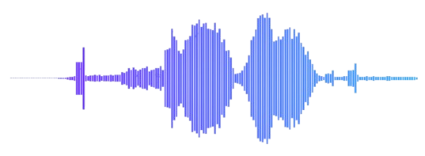






(a)
(b)
(c)
(d)
(e)
(f)
(g)
Fig. 2: Preprocessed and augmented signals (a) raw data, (b) cleaned signal, (c) noise added signal, (d) high pitch shifted signal, (e) low pitch shifted signal, (f) fast time stretched signal and (g) slow time stretched signal

Slide 11
Methodology (Cont.)
Framing and Windowing
Feature Extraction
Fourier Transform
The most widely used and accepted feature extraction method for voice signals is the Mel-Frequency Cepstral Coefficients (MFCCs).
MFCCs capture key speech characteristics by converting audio signals into a form usable for machine learning.
Breaks down the speech into time frames and analyzes its frequency components.
Very complex mathematical computations.
Directly applied using python library.
Mel Filter Bank
Logarithmic Compression
Discrete Cosine Transform
Delta Coefficients
Final Feature Vector
Fig. 3: Feature extraction steps

Slide 12
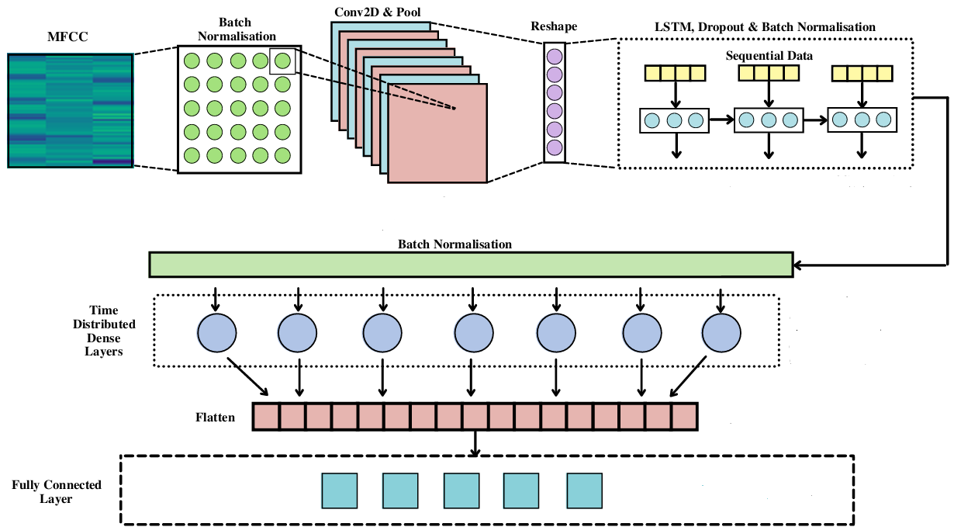
Methodology (Cont.)
Model Architecture
CNN-LSTM Hybrid Model
Convolutional layers for feature extraction.
LSTM layers for temporal dependencies.
Final softmax layer for classification
Fig. 4: Model Architecture [6]

Slide 13
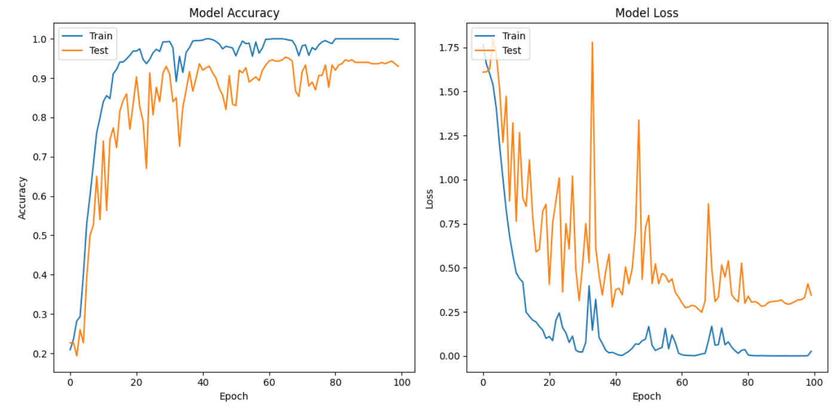
Methodology (Cont.)
Training
Training and Testing set are split into 80:20 ratio with Testing set containing some defective commands.
Training set further split into 75:25 ration for actual training and validation.
Batch size: 20 samples
Epochs: 100
Training Accuracy : 99.89%
Validation Accuracy: 93.00%
Fig. 5: Training and Validation Accuracy

Slide 14
Methodology (Cont.)
Training (80%)
Training (75%)
Dataset
Testing (20%)
Validation (25%)
Preprocessing
Clean Signal
Data Augmentation
Pitch Shift
Time Stretching
Add Random Noise
+250
Extract MFCC Features
High
+250
Low
+250
Fast
+250
Slow
+250
Train Model
Batch Size = 20
Training Accuracy = 99.89%
Epochs = 100
Validation Accuracy = 93%
Save Model
Test Model
Testing Accuracy = 81%
Fig. 6: Complete Workflow

Slide 15
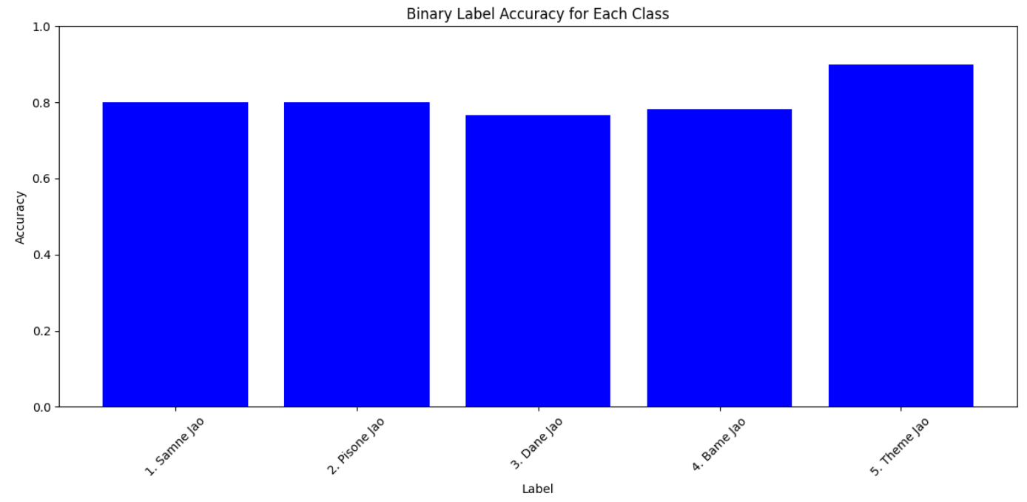
Results
Test Set Accuracy: 81%
Command-specific Accuracy:
Samne Jao: 80%
Pichone Jao: 80%
Dane Jao: 76.67%
Bame Jao: 78.33%
Theme Jao: 90%
Robust against defective inputs and noisy environments.
Fig. 7: Label by Label Testing Accuracy

Slide 16
Result Analysis
Adaption to small command defections.
“Baye Jao” “Bame Jao”
“Piche Jao” “Pichone Jao” etc.
Reasonable adaption to moderate command defections.
“Sanne Jao” “Samne Jao” etc.
Misclassification in case of huge defection
“Thamo” “Theme Jao” “Samne Jao” or “Bame Jao”
As the word “Thamo” has less phonetic defection distance to labels “Samne Jao” or “Bame Jao” compared to “Theme Jao”.

Slide 17
Result Analysis (Cont.)
The comparative lower accuracy between “Bame Jao” and “Dane Jao” is because of their phonetic similarity which could lead to occasional misclassifications.
Trade off
Actual Classification Defection Allowance
More defection allowance will lead to less accuracy in case of the actual classification.
As the overall phonetic distance between clusters of classes will decrease significantly.
Specially for already close distant classes like “Bame Jao” and “Dane Jao”.
Thus a middle ground is taken by allowing most of small defections.
With a reasonable moderate defections.

Slide 18
Real Time Testing
Live microphone with 3 sec interval (changeable) to capture commands in real time.
Tested system’s ability to recognize commands in real-world conditions.
Audio recorded via the mic is preprocessed in real-time.
The model predicts the command instantly.
Enables hands-free control for small robotic vehicles in real environments.
Live Audio (3 Sec Interval)
Clean Signal
Extract MFCC Features
Make Predictions
Assign Labels
Fig. 8: Real Time Testing steps

Slide 19
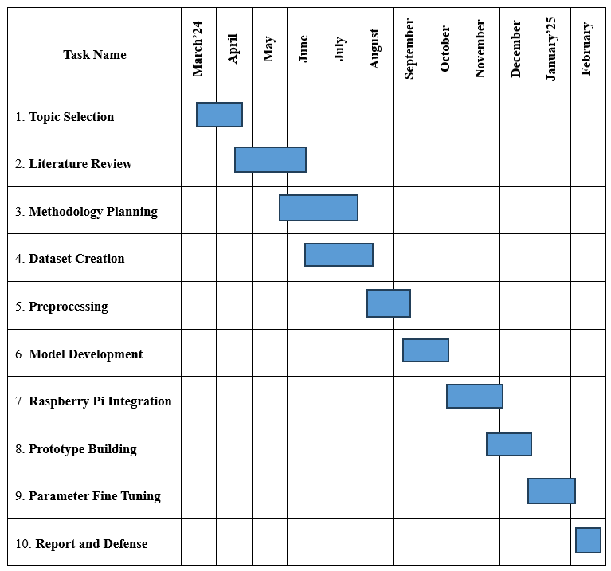
Progress
Fig. 9: Gantt Chart

Slide 20
Limitations
Small dataset: 250 samples.
Phonetic similarities between commands.
Trade off between Actual classification and Defective allowance.
Future Planning
Optimize model for low-latency, real-time use on embedded systems.
Hardware implementations (Raspberry Pi).
Building a protype to analyze actual usage.
Integrate more commands or extend to other languages.

Slide 21
Conclusion
Developed a lightweight, custom-built and robust model for offline voice command recognition in Bengali.
Demonstrated the system’s ability to handle slight pronunciation errors.
Achieved reasonable accuracy with CNN-LSTM architecture.
Practical applications in low-resource environments.
Future improvements include hardware implementation and optimization.

Slide 22
References
M. R. Sultan, M. M. Hoque, F. U. Heeya, I. Ahmed, M. R. Ferdouse and S. M. A. Mubin, "Adrisya Sahayak: A Bangla Virtual Assistant for Visually Impaired," 2021 2nd International Conference on Robotics, Electrical and Signal Processing Techniques (ICREST), DHAKA, Bangladesh, 2021, pp. 597-602, doi: 10.1109/ICREST51555.2021.9331080.
D. Gupta, E. Hossain, M. S. Hossain, K. Andersson and S. Hossain, "A Digital Personal Assistant using Bangla Voice Command Recognition and Face Detection," 2019 IEEE International Conference on Robotics, Automation, Artificial-intelligence and Internet-of-Things (RAAICON), Dhaka, Bangladesh, 2019, pp. 116-121, doi: 10.1109/RAAICON48939.2019.47.
S. Ahmed Sumon, J. Chowdhury, S. Debnath, N. Mohammed and S. Momen, "Bangla Short Speech Commands Recognition Using Convolutional Neural Networks," 2018 International Conference on Bangla Speech and Language Processing (ICBSLP), Sylhet, Bangladesh, 2018, pp. 1-6, doi: 10.1109/ICBSLP.2018.8554395.

Slide 23
References
N. Sadeq, S. Ahmed, S. S. Shubha, M. N. Islam and M. A. Adnan, "Bangla Voice Command Recognition in end-to-end System Using Topic Modeling based Contextual Rescoring," ICASSP 2020 - 2020 IEEE International Conference on Acoustics, Speech and Signal Processing (ICASSP), Barcelona, Spain, 2020, pp. 7894-7898, doi: 10.1109/ICASSP40776.2020.9053970.
G. K. Berdibayeva, A. N. Spirkin, O. N. Bodin and O. E. Bezborodova, "Features of Speech Commands Recognition Using an Artificial Neural Network," 2021 Ural Symposium on Biomedical Engineering, Radioelectronics and Information Technology (USBEREIT), Yekaterinburg, Russia, 2021, pp. 0157-0160, doi: 10.1109/USBEREIT51232.2021.9455111.
A. Yasmeen, F. I. Rahman, S. Ahmed and M. H. Kabir, "CSVC-Net: Code-Switched Voice Command Classification using Deep CNN-LSTM Network," 2021 10th International Conference on Informatics, Electronics & Vision (ICIEV), Kitakyushu, Japan, 2021, pp. 1-8, doi: 10.1109/ICIEVicIVPR52578.2021.9564183..

Slide 24
Thank You

